Slide 1
Annual DA Lottery Process

Slide 2
PRE-Submission Tips (Slide )
TABLE OF CONTENTS
Reminders
SCE Support and Forms Link

Slide 3
The Purpose
The SCE Customer Choice Services team’s purpose is to enable customer choice by facilitating customer enrollment in Direct Access (DA) service.
Our key objective is to provide guidance to support customers and their authorized Third-party representatives in their submissions by providing the following DA Lottery submission tips for the upcoming Direct Access (DA) Lottery.

Slide 4
Completing the PDF Document
Please ensure to submit the given document and duly sign the section marked in green. To minimize potential errors, it is recommended to input ‘See Attachment’ in the section for account information and provide all necessary account details in the associated spreadsheet.
Notes:
“Please ensure to submit the given document and duly sign the section marked in green. To minimize potential errors, it is recommended to input ‘See Attachment’ in the section for account information and provide all necessary account details in the associated spreadsheet.”

Slide 5
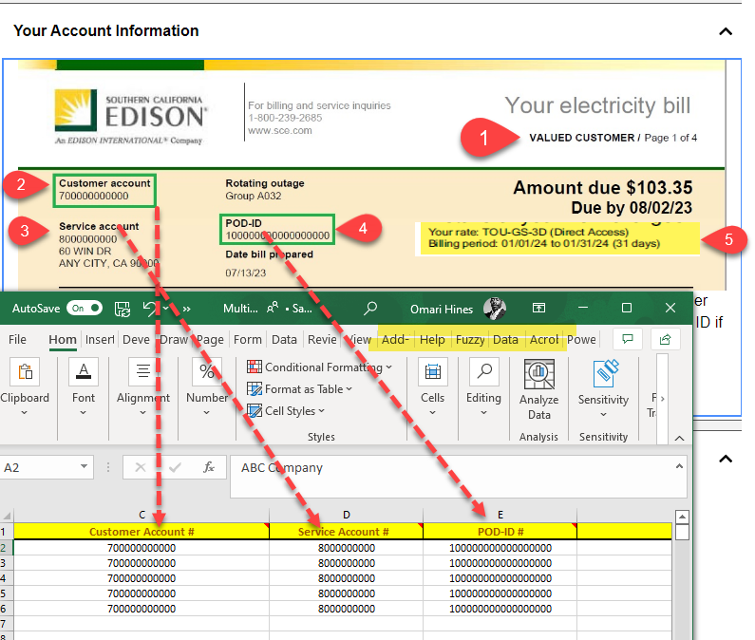
Completing The Excel Spreadsheet
Customer’s Name: Obtain the name of the customer.
Customer’s Account: Get the account details of the customer.
Service Account: Access the service account related to the customer.
POD-ID: Retrieve the POD-ID associated with the account.
Verify DA Status: Refer to page 4 of the bill and confirm that the account is not on Direct Access (DA) before sending the Six-Month Notice to SCE.
Update Spreadsheet: Enter the relevant details from the bill into the spreadsheet. This includes all the information gathered from the previous steps.

Slide 6
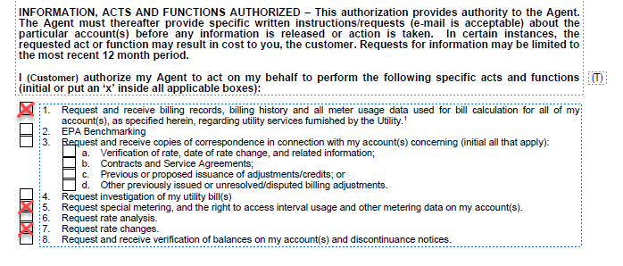
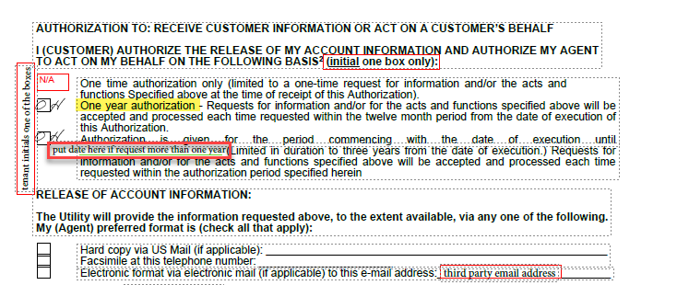
Completing The CISR Form
Make sure both sections are initialed before proceeding
Work together with the customer to determine the duration of authorization.
Notes:
Please send the CISR to danotices@sce.com

Slide 7
Completing The CISR Form Continued
Ensure that the form is signed and dated to avoid rework
ABC Company

Slide 9
Send an email to danotices@sce.com with a CISR request for billing history and interval data, by 5/11/24

Slide 10
The submission period is from 9:00 a.m. on June 10, 2024, to 5:00 p.m. on June 14, 2024, PDT. Please note that late DASRs will not be accepted.

Slide 11
Make sure to put the information from the Customer current to avoid rejections and rework

Slide 12
The load offering with lottery sequence number will be sent before 8/12/24 Deadline

Slide 13
In the event you accept, you will not be able to submit your DASR until 12/31/24. Using the start date from the January meter reading, SCE could submit the DASR on your behalf in advance.

Slide 14
If a customer declines, or fails to respond to the waitlist, they will be removed from the current year's waitlist. As a result, they will continue to receive their existing utility bundled service or CCA service.

Slide 15
Your Direct Access Service Request (DASR) cannot be submitted until the 1st of January.
However, SCE could submit the DASR on your behalf in advance, using the start date from the January meter reading.

Slide 16
Customers who accept but fail to submit a DASR by the due date will be transitioned to the Transitional Bundled Service as per the current Switching Exemption Rules.
Note If you are a CCA Customer, and SCE does not receive a DASR from you by the specify date, then this notice will be canceled, and you will continue to take service from your CCA

Slide 17
To avoid incurring additional costs and being disqualified from the DA Lottery for a minimum period of 18 months, it’s crucial that your customer thoroughly reads the Six-Month Notice Form before saying ‘Accept’.

Slide 19
SCE Support and Forms Link
Typical Bill Breakdown
Customer Information Service Request (CISR) 14-796
Partial Reopening of Direct Access | Direct Access Overview | Partnerships | Partners & Vendors | Home – SCE
Sample: Six-Month Advance Notice to Transfer to Direct Access Service (sce.com)

